Slide 1



Single cell sequence data to facilitate Maize kernel row number gene discovery
Lin Du
Thanks to Keith Decker, Jiani Yang,
Benjamin Buer and Rebecca Lowdon
Notes:
Hi everyone, today Sarah and I are going ...

Slide 2
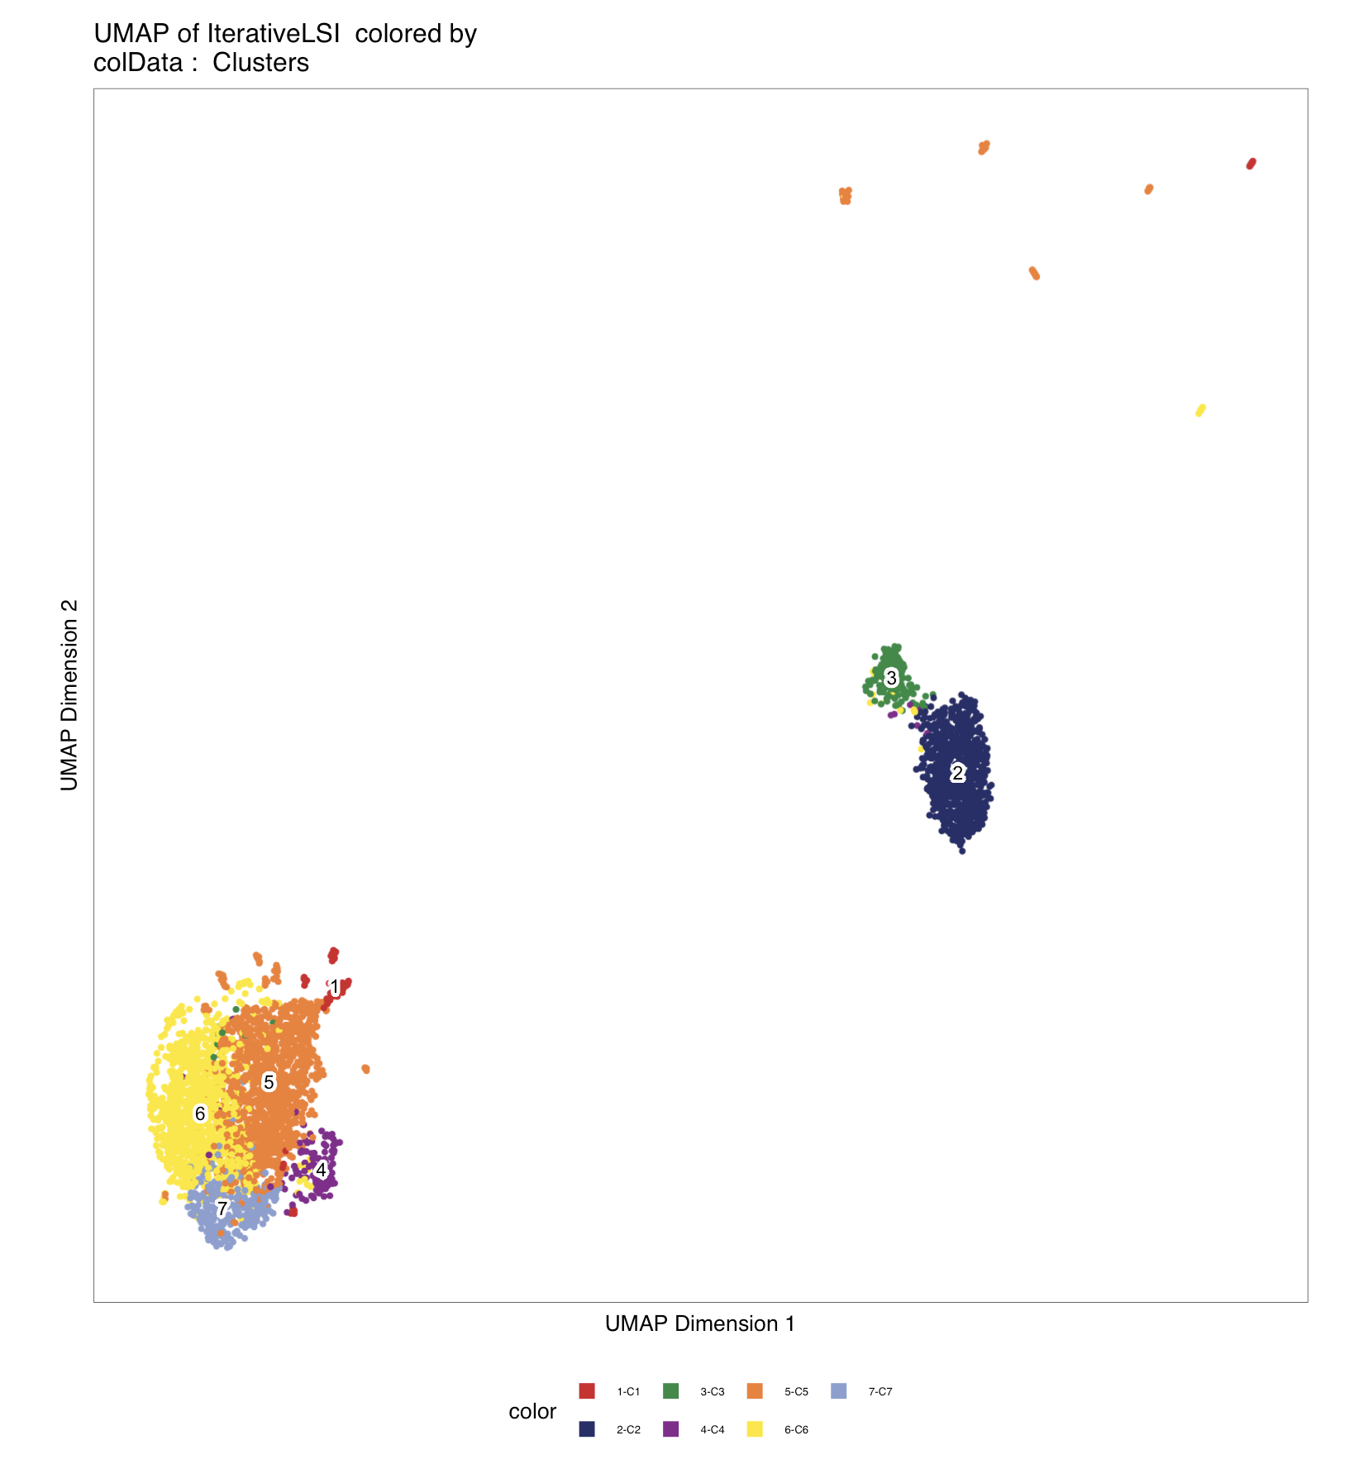
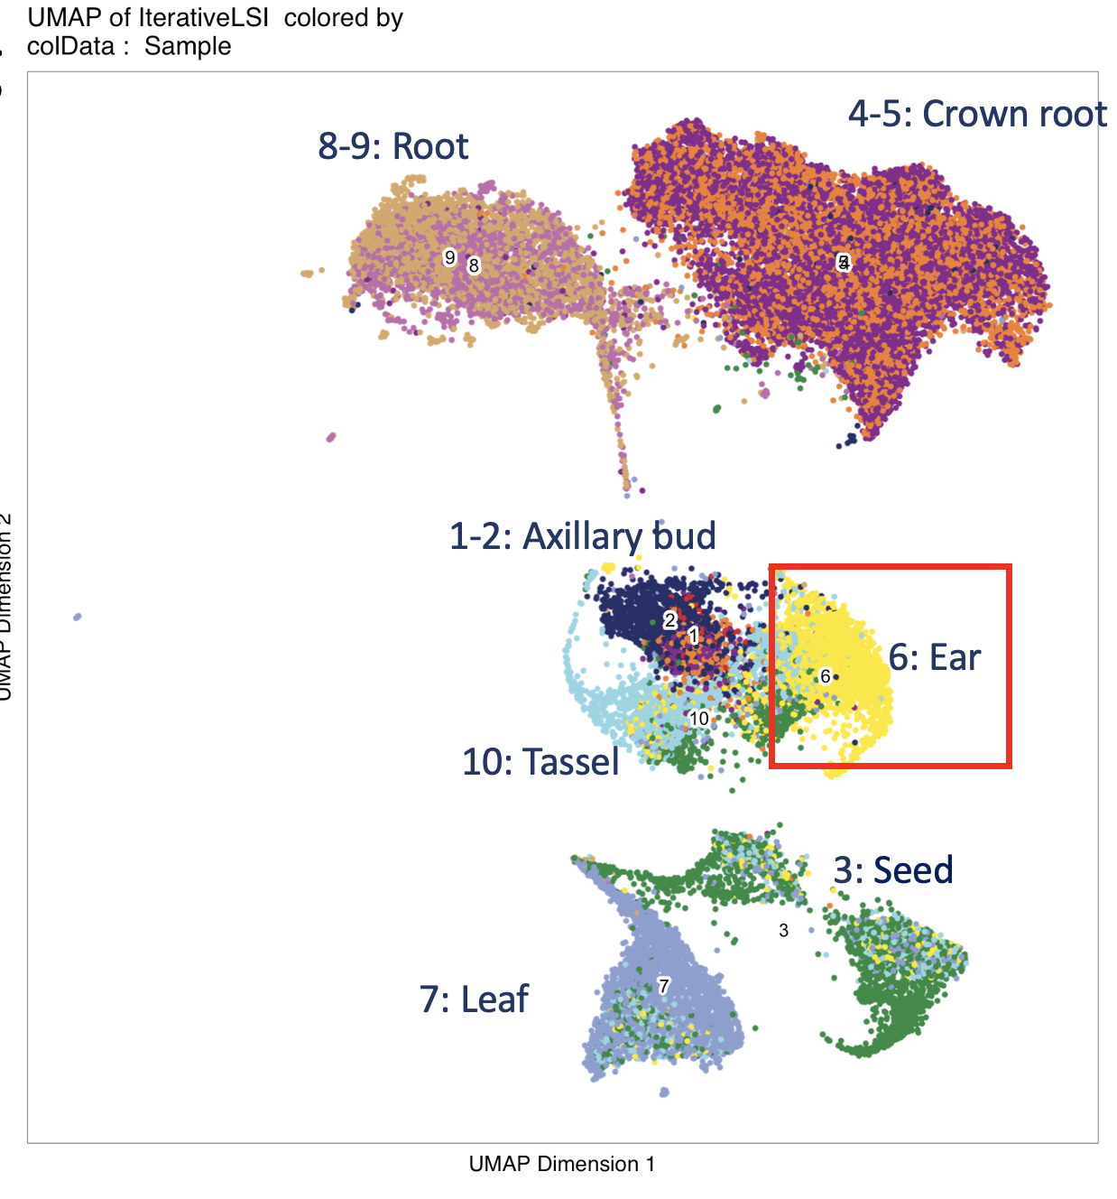
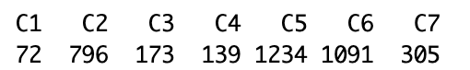
Single cell ATAC-seq data of Ear tissue
3,967 cells

Slide 3
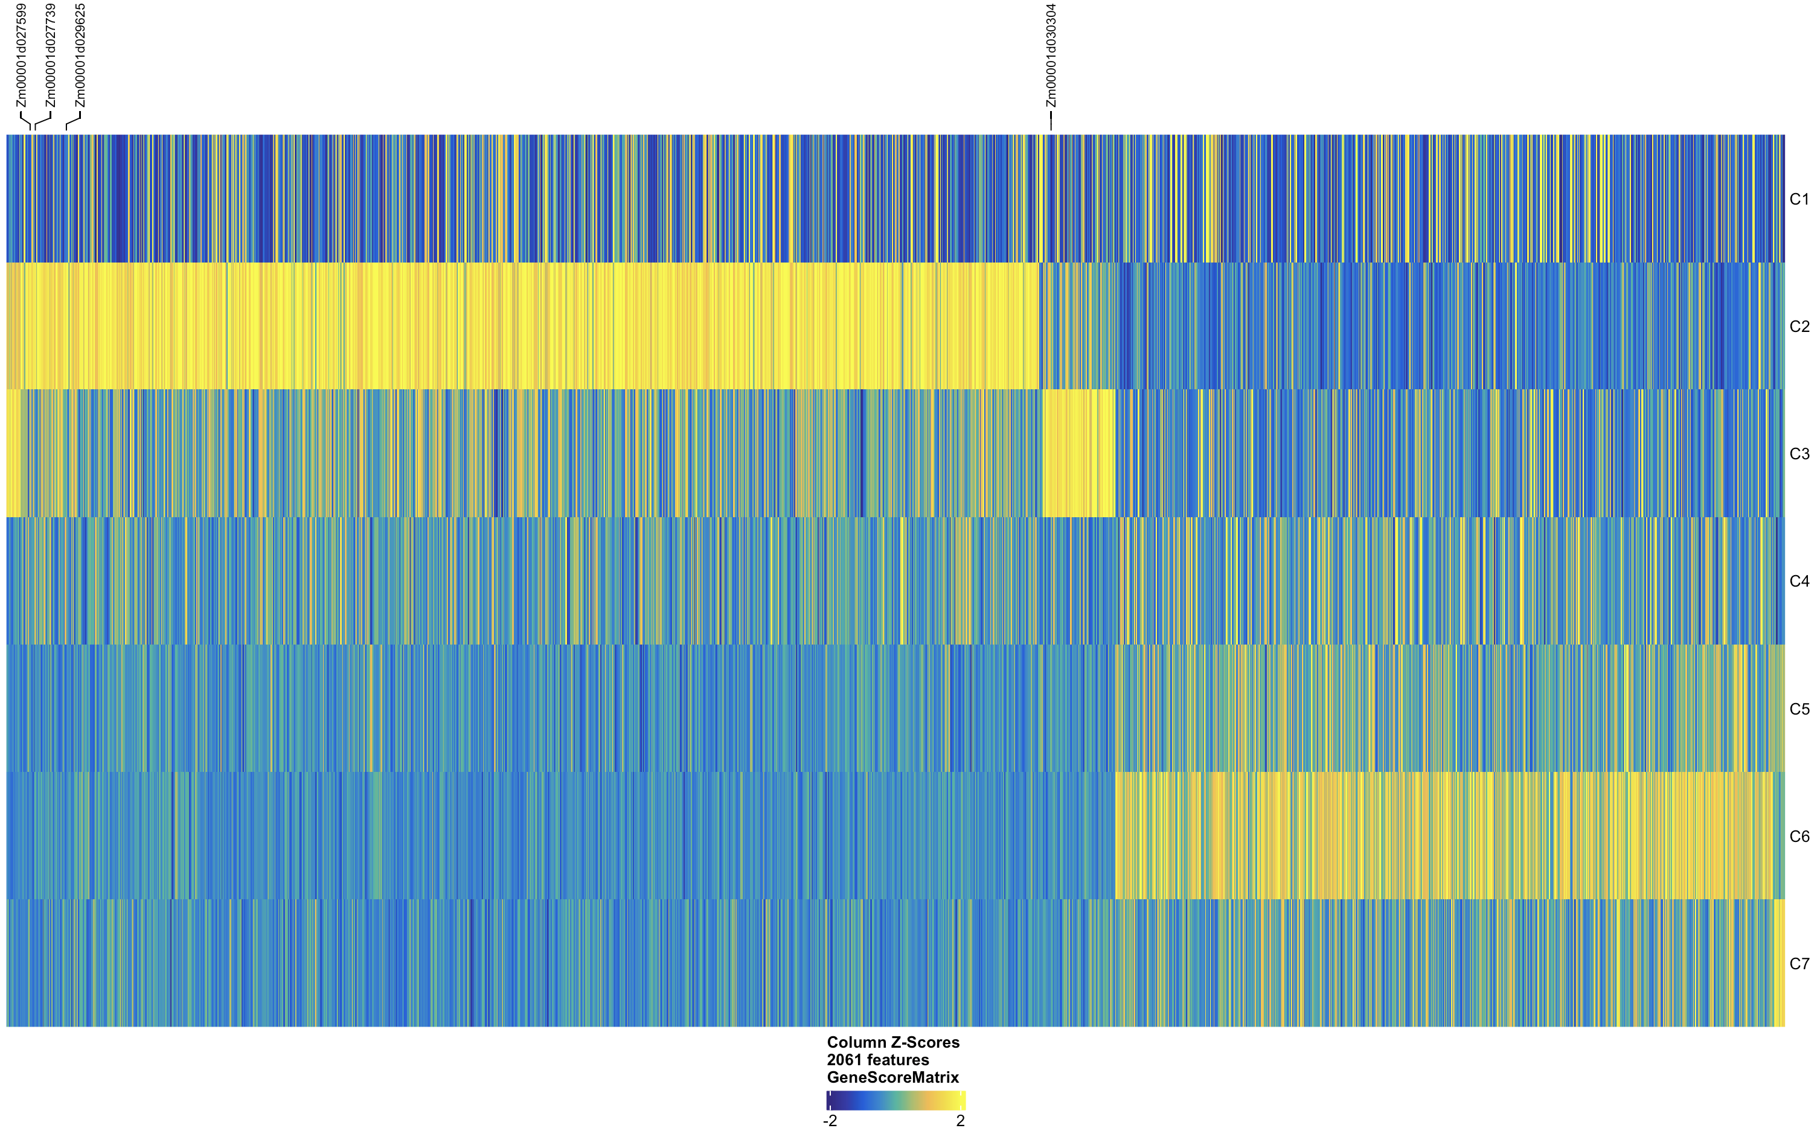
Single cell ATAC-seq data contains cell specific information
Based on the ATAC-seq peak height at TSS of genes
FDR <= 0.05 & Log2FC >= 1 2061 genes

Slide 4
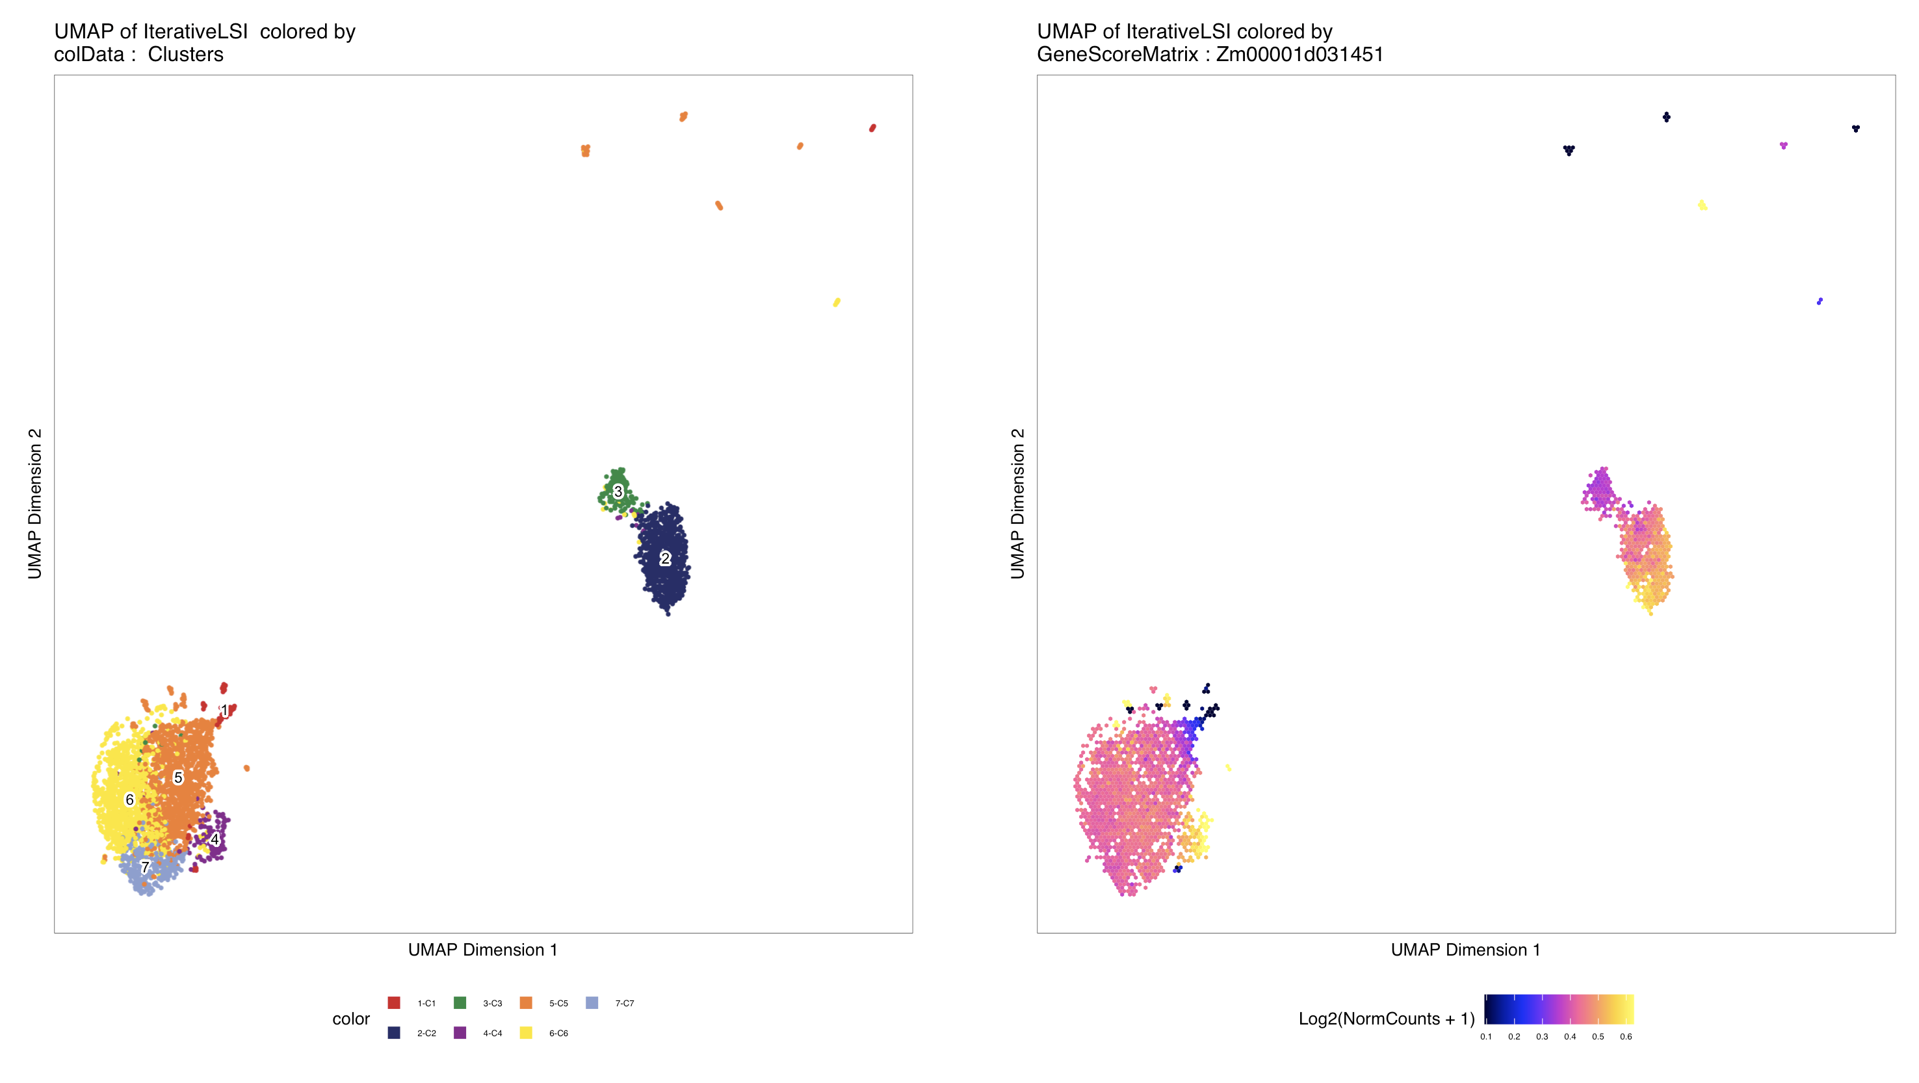
Single cell ATAC-seq data helps to define cell type specific genes
UB2
Sc ATAC-seq detects cell specific expression of UB2,
which was not detected by sc RNA-seq

Slide 5
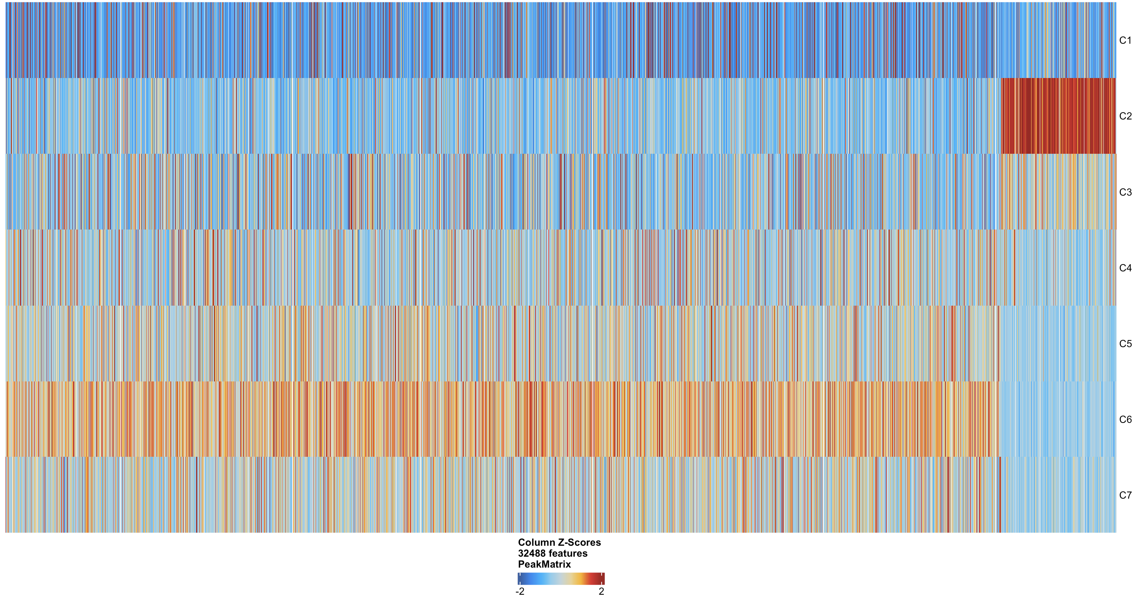
Identify marker peaks

Slide 6
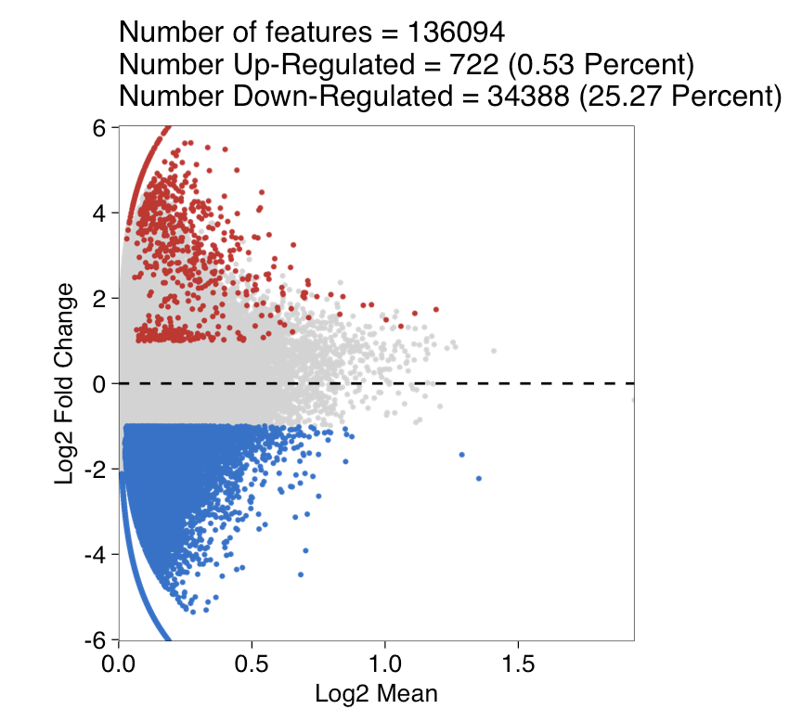
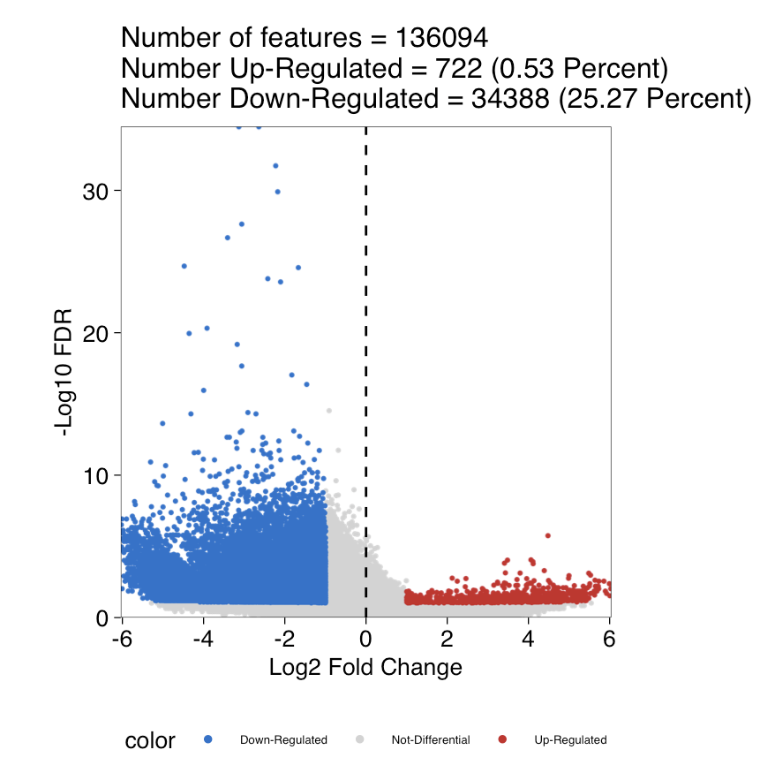
Pairwise Testing Between clusters
C2_vs_C6

Slide 7

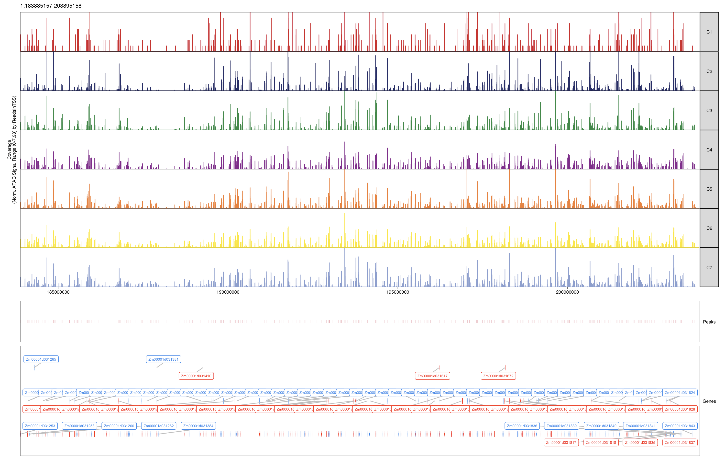
Single cell ATAC-seq Peak shows chromatin open region difference among clusters
QTL1
ATAC-seq peaks
for each cluster
Figure made by ArchR

Slide 8
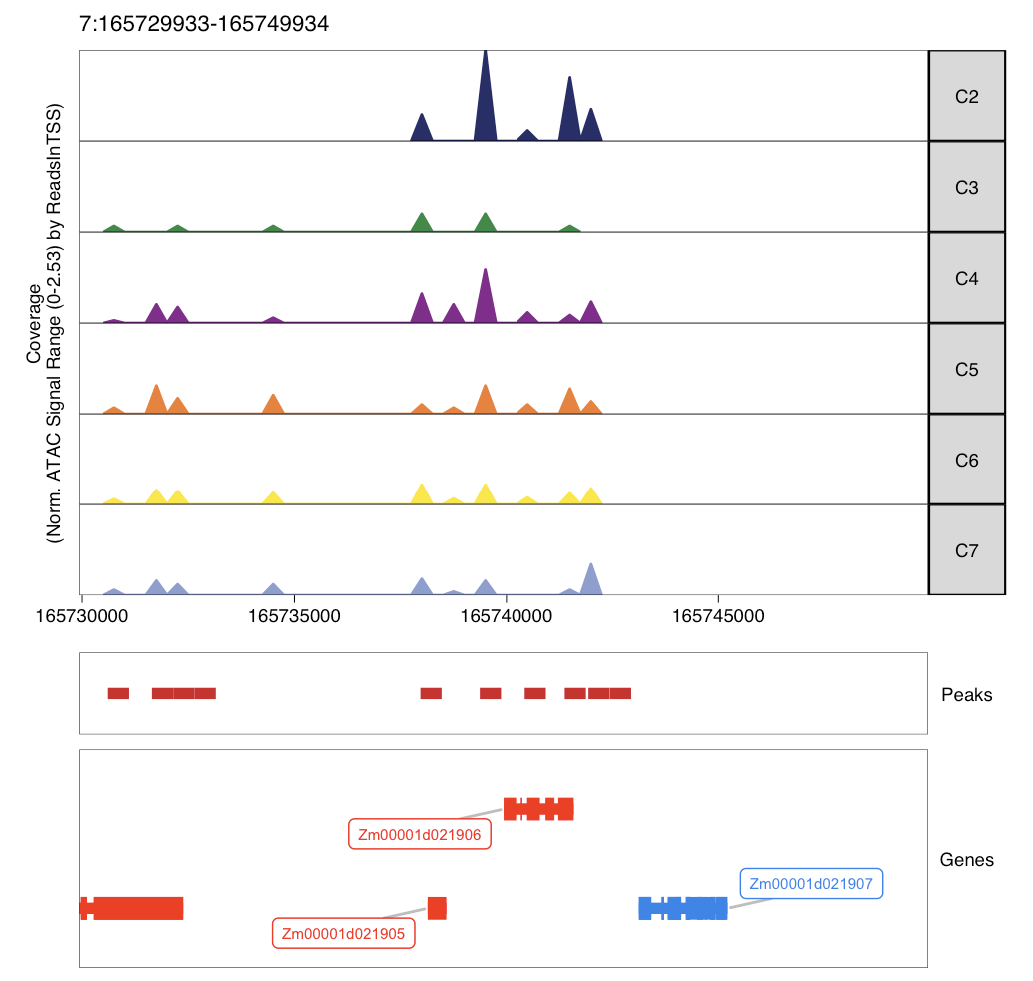
Marker ATAC-seq Peak shows gene Transcription Start Site open level difference among clusters
Zm00001d021906 (lhca2): is important for maize to improve photosynthesis under abiotic stresses, such as drought and low temperature

Slide 9
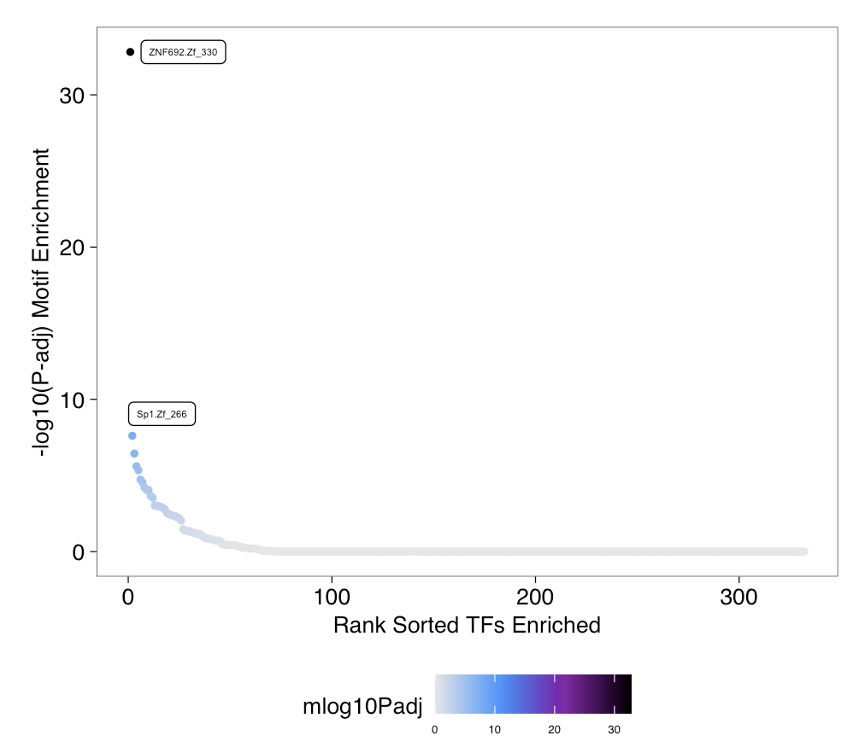
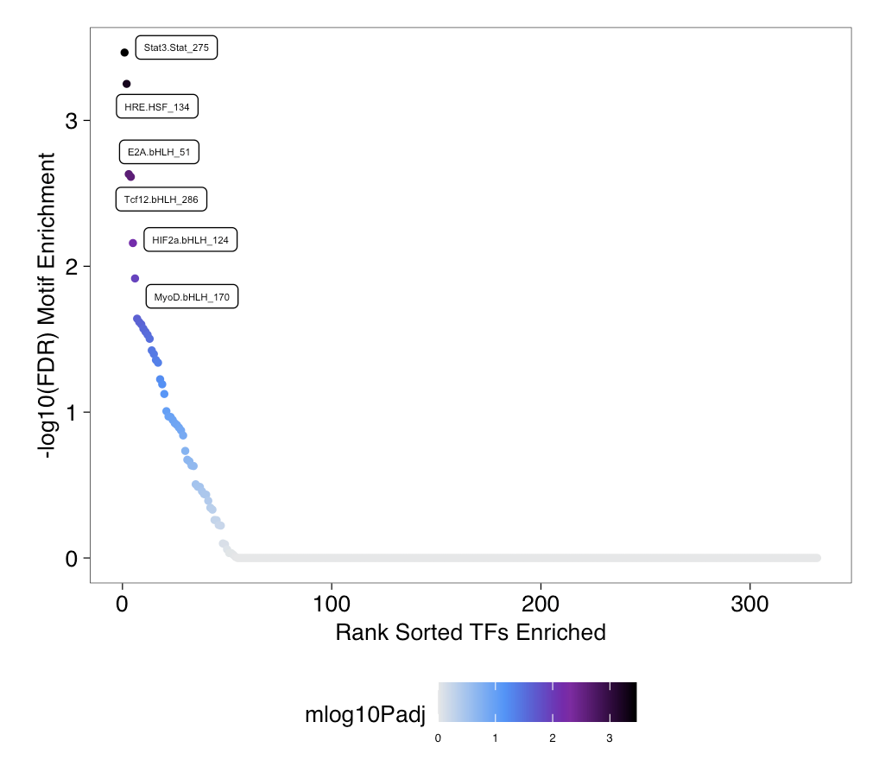
Motif enrichment difference between C2 and C6
Single cell ATAC-seq predict motif and transcription factors from accessible chromatin sites.
HOMER
C2 enriched
C6 enriched
Stat3.Stat_275
HRE.HSF_134
E2A.bHLH_51
Tcf12.bHLH_266
HIF2a.bHLH_124
MyoD.bHLH_170
ZNF692.Zf_330
Sp1.Zf_266

